Slide 1

New Delhi
26th Dec 2018

Slide 2
Innovation @ Aarkaya
We are Generation Solar
From transport to farming, from homes to school,
solar is powering our lives in more ways then ever before.
The government has targeted 100GW of solar capability by 2020, a five fold increase.

Slide 3
Our Current Market Presence
120 +
2,10,000 INR
38,00,000 INR
Debtors
Revenue
188 KWH
87 KWp +
Solar Power Generated Per Hour
Orders in Pipeline
20 +
10
Vendors Associated
Orders delivered Successfully
Other than the above mentioned information, Aarkaya Solar Solutions Pvt Ltd has an inventory worth INR 2,20,000 with a projected revenue of over 47 Lacs in the next 4 months.

Slide 4
Ever since the idea was instigated on October 9, 2017;
the entire team is working rigorously in their respective fields to bring a cumulative strength to the organization.
The initial 4 months were taken to conduct market research/ surveys, formulate and finalize a tentative model,
plans, and financial projections for the venture.
Within a very short span (since incorporation on March 1, 2018) of an initial run of the concept venture,
Aarkaya Solar Solutions Pvt Ltd has managed to gather a fair traction in terms of customer acquisition,
monetary profitability, feedbacks, etc. Certain facts and figures for further understanding of the company’s
market presence are presented here.

Slide 5
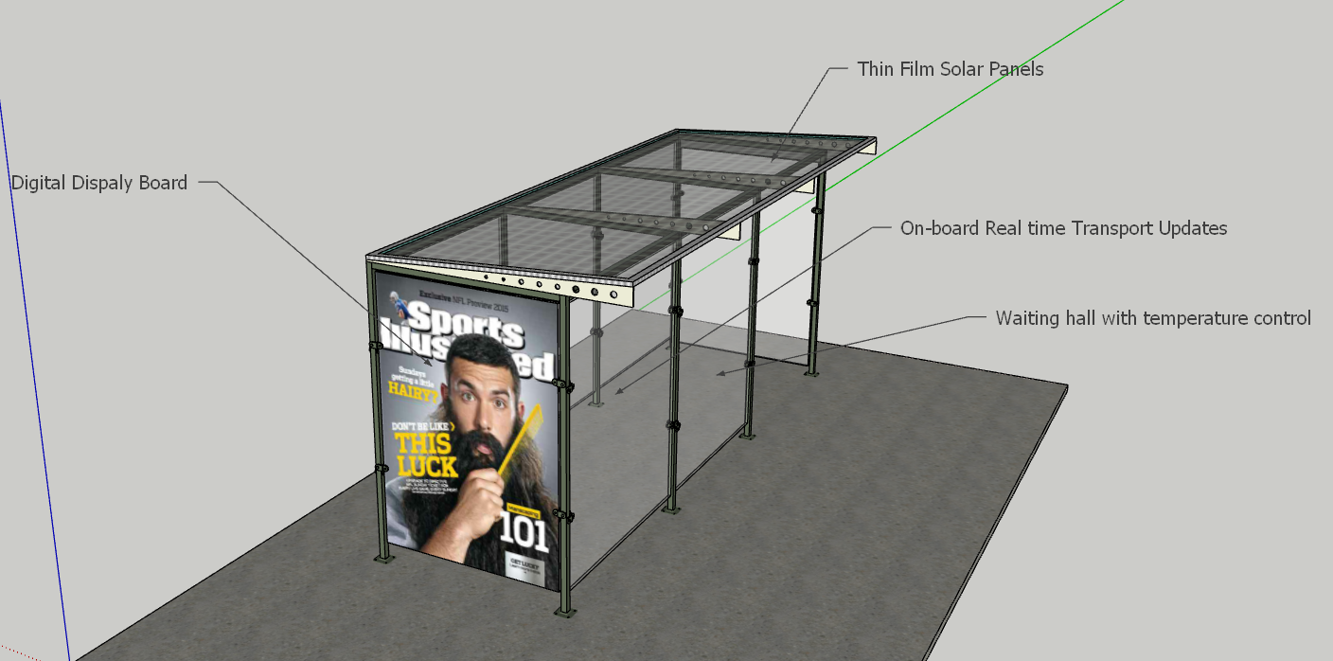
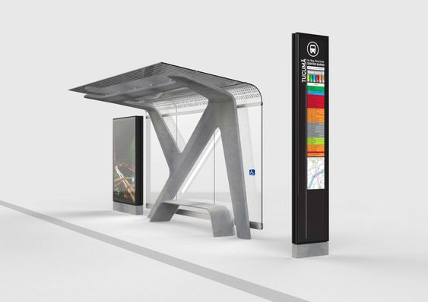
Features of Smart Solar Platforms
Advertising
In-house CMS
Centralized management
Highly Targeted Delivery
Low Cost, Wide reach
Self-sustainable
Smart Wi-Fi
Data Collection
Public Safety
LED Ambient Lighting
Free Charging

Slide 6
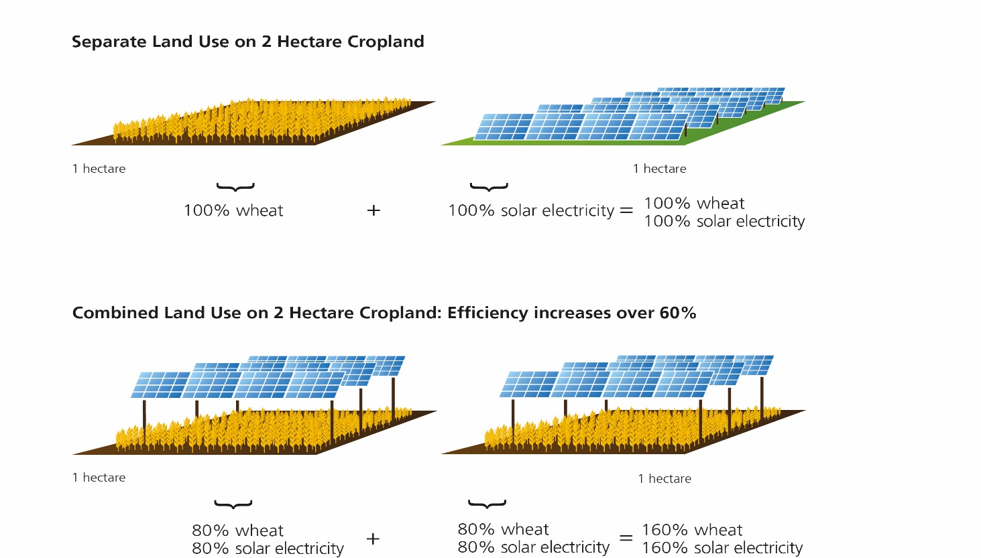
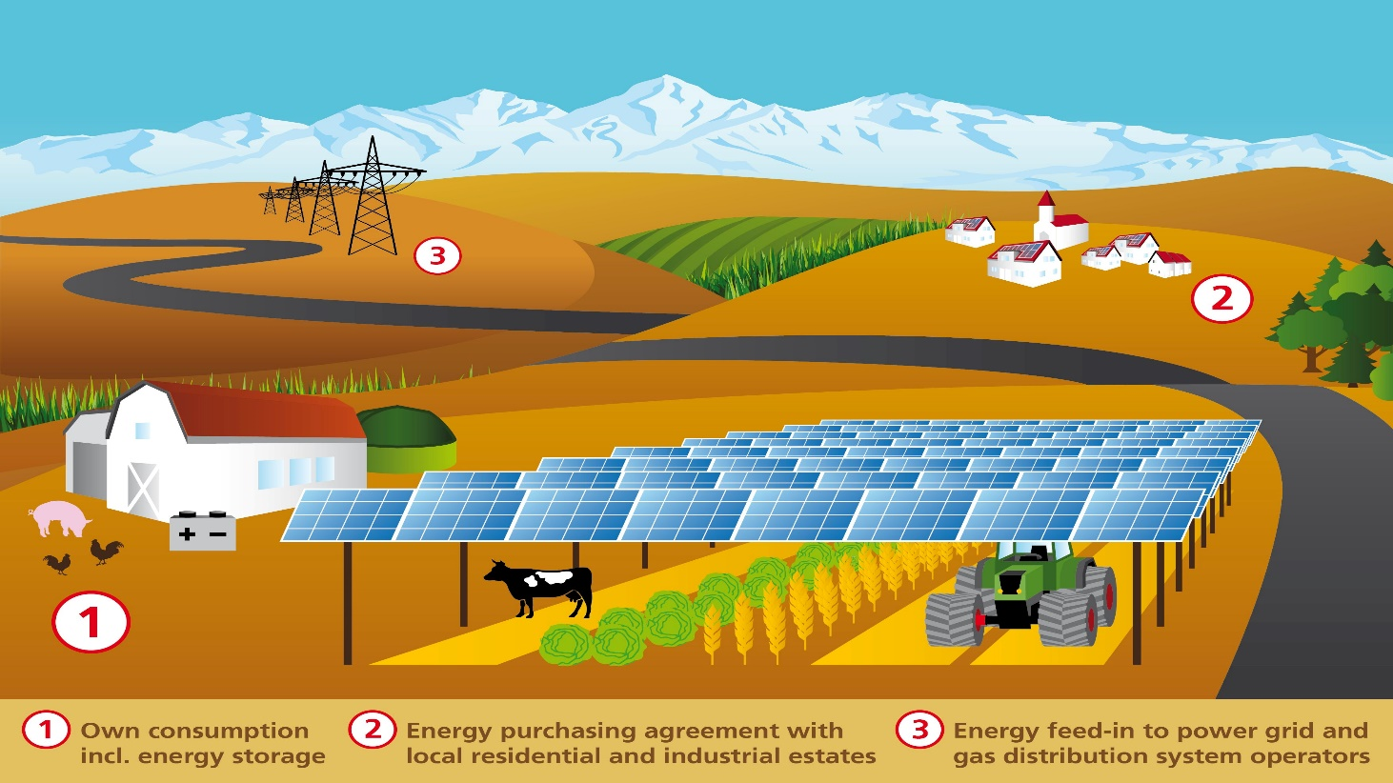
Agro-Photovolatic System
Dual use of land
Opens up a new source of income for farmers.
Mitigate the conflicting interests between agriculture and open space PV systems for viable land.
The 720 bifacial solar modules

Slide 7

Future, via Aarkaya
We have planed a new era of Energy Generation and Distribution ahead:
Implementation of Blockchain.
Blockchain-based Solar Energy Trading
Decentralisation of Power Generation
Blockchain and IoT are Driving Solar Generation and Distribution.

Slide 8
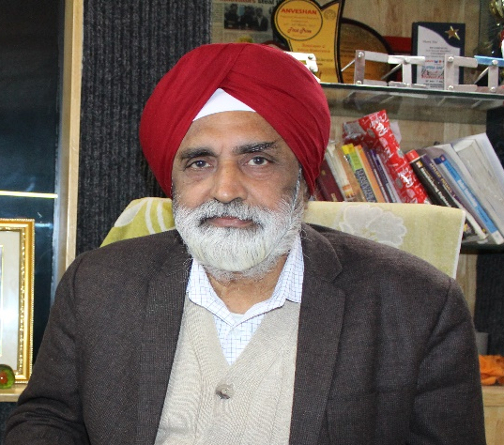
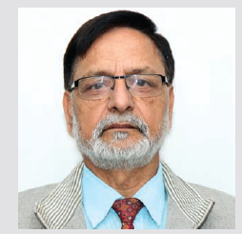

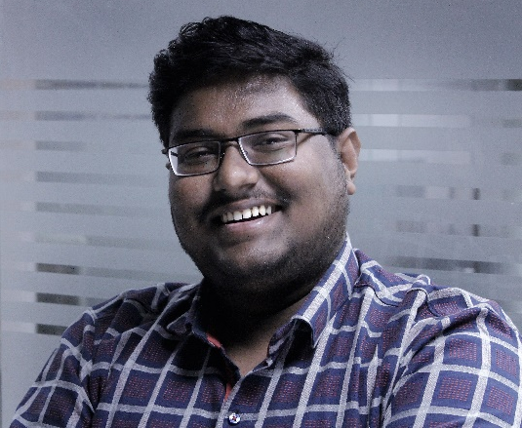
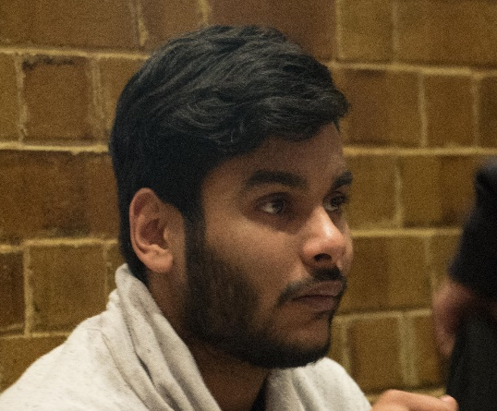
Team Strength
Advisory Board
Dr. B.S. Gill
Dr. BM Bahal
Mr. Rahul Narvekar
Dr. Bindu Agrawal
Financial Advisor
Consulting Body
Mr. Karan Narula
Niti Aayog
Directors
Mr. Sumit Bhatnagar
Director Sales
Conect2India
Shivendra Singh Chauhan
Bilaval Aziz

Slide 9



Recommendations and Testimonials
In talks with MCL (Municipal Corporation of Lucknow) for developing Smart Solar Charging Kiosk and Smart Solar Benches
In talks with Bihar Ministry for smart city development
In talks with Mayor of Lucknow for advertising and implementing our projects
The concept of smart solar charging kiosk and Smart Solar Benches have been appreciated by:
Dr. BN Sarkar - Scientist-G (DSIR) & Director - Central Electronics Limited
Mr. Alok Kumar - P.C.S. Secretary& Chief Project Officer, UPNEDA
Mr. Ashok Kr. Srivastava - Senior Project Officer, UPNEDA
Mohd. Salam Khan – Government of Bihar

Slide 10
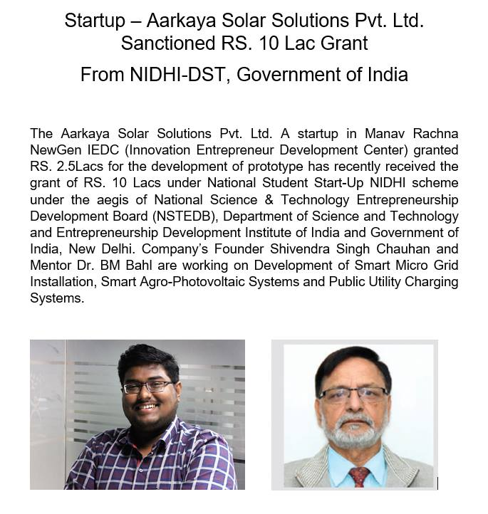
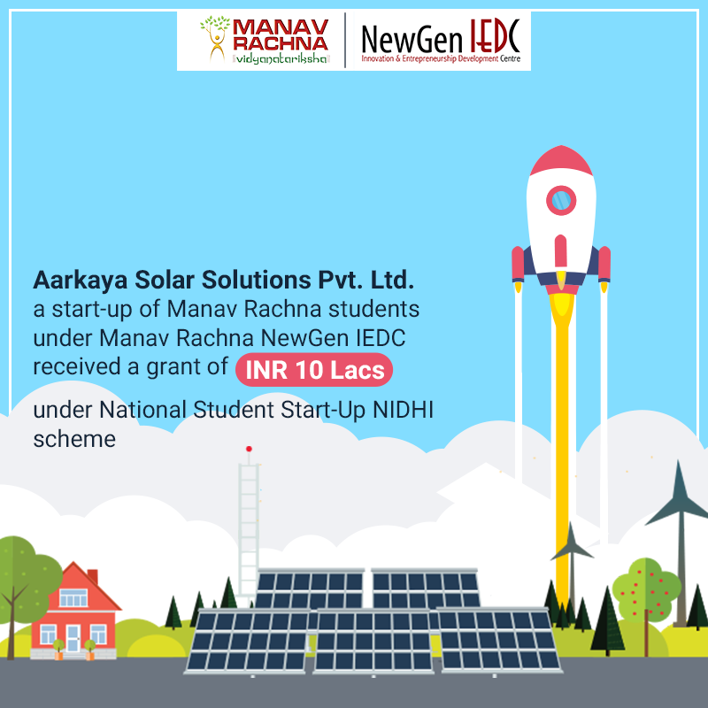
Milestones Achieved

Slide 11
Glimpses of the Team on Field
Aarkaya Solar Solutions Pvt Ltd has contracted over 21 installers and engineers who assist them in the process of their order fulfillment.

Slide 12
Thank You
"We're changing the way we relate to our business customers and delivering what they really need."

